Slide 1




Echo Medical System
EHCO SYSTEM
Hospital Management System
https://zeyad4a.github.io/ix/

Slide 2

Contents
01
02
03
Introduction
Proposed Solution
Project Features
04
05
06
Project Management
Field Trips
Tools And Methods
07
08
Future Work
Project conclusions

Slide 3

Introduction
While we were in the medical facilities, we faced a problem that represented a major disaster
It Was Waiting And Crowding .
If there is a patient who cannot wait, even if it's possible,
Waiting is also considered a risk for some medical conditions that cannot wait And crowding is always a problem. Because it's the best environment for the transmission and spread of diseases.
Therefore, this represents a disaster because transmitted diseases favor crowding and human gatherings. Therefore, it's never preferable to crowd inside hospitals because hospitals are considered the preferred home for diseases, even if the diseases spread and begin to expand, as happened in the period between 2019 to 2021 with COVID-19 and the curfews that occurred and the cessation of all lifestyles
So that this does not happen again, this is where the idea of ​​the Eco System came from It came

Slide 4
Proposed Solution
Patient comfort is the goal of any successful medical organization
We tried to interact as much as possible with medical settings to explore the problems that patients face
01.
Therefore, in our project, our first and most important purpose is to facilitate the medical process in all its stages for the patient, from the beginning of booking to receiving the examination and treatment report.
We spoke with those in charge of medical clinics. We spoke with doctors and patients
02.
We were able to identify the problems we mentioned earlier in the introduction
We thought about the best way to ensure the patient's comfort and the efficiency of the service provided
And we came up with Echo System
Our project is considered an effective way to organize appointments and reservations and automate the patient's sick record so that he can access his medical record through our website.
03.

Slide 5


Project Features
Our project is considered an effective way to organize appointments and reservations and automate the patient's sick record so that he can access his medical record through our website.
The project provides integration between the management system and organizing reservations and patient reports.
We can collect some of the advantages as follows

Slide 6


Features
makes it easier for both the patient, the medical organization owner, and the doctor.
organization's employees deal with the system and they found it easy to use
aim to meet the needs of patients because they need service.
Booking from his home on any convenient date
Follow up on the inspection report
Possibility of printing it
Patients can easily access their complete medical records and doctors can write reports directly within the user-friendly system.
Knowing the status of the reservation, whether it has been cancelled, awaiting, or an examination has been performed

Slide 7
also facilitated the management process within the organization
Admins can Monitor daily reservations, active employees on the system, and active doctors
Admins can Follow up on the financial process in detail.
Admins can Add new doctors, new employees, assign permissions, and manage specialties.
Simple and Eye-Friendly User Interface to Facilitate Use and Supervision of the Organization in Terms of Management and Organization
Super Admin And Administrator Have The Ability To Print Payment Receipt

Slide 8

Project Management
Project management is considered one of the most difficult steps taken during the implementation of our project. Recently, we held a number of meetings to take decisions and implement the project in the best and most appropriate way to facilitate the reservation and inspection process.
The project took 4 months to complete
During this period, we met several times and documented these meetings

Slide 9
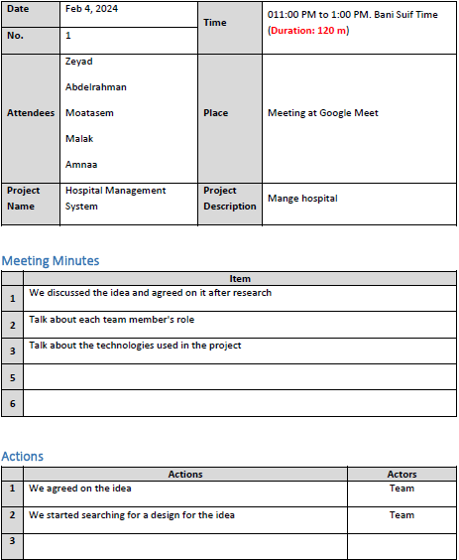
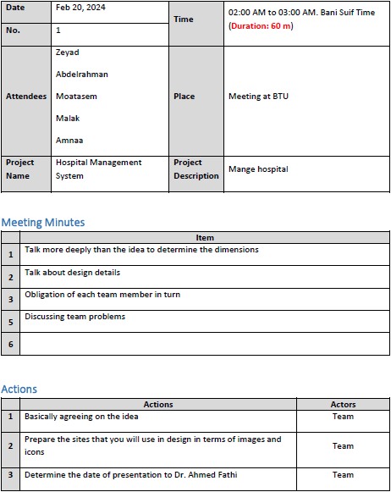
Meetings for Echo Team
MORE HERE...

Slide 10
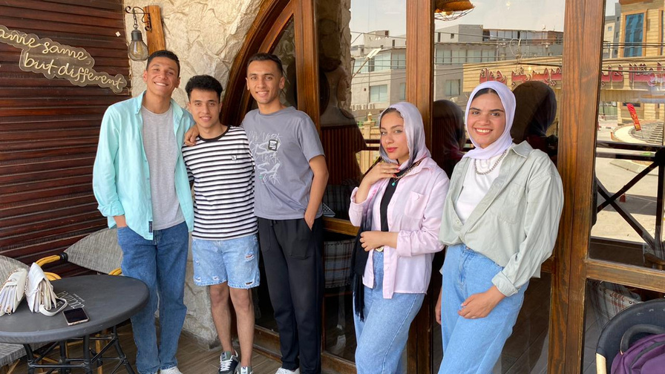
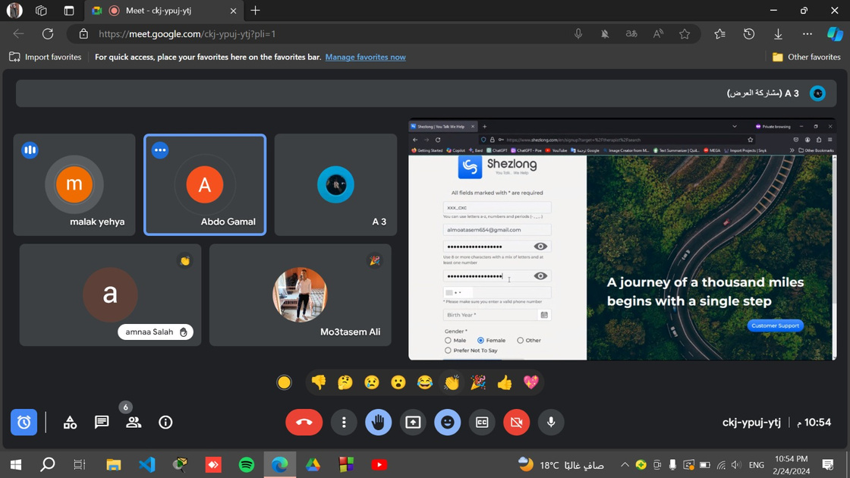
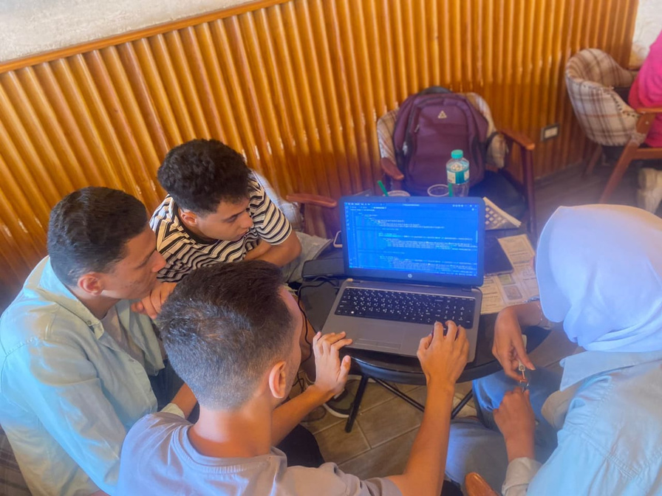
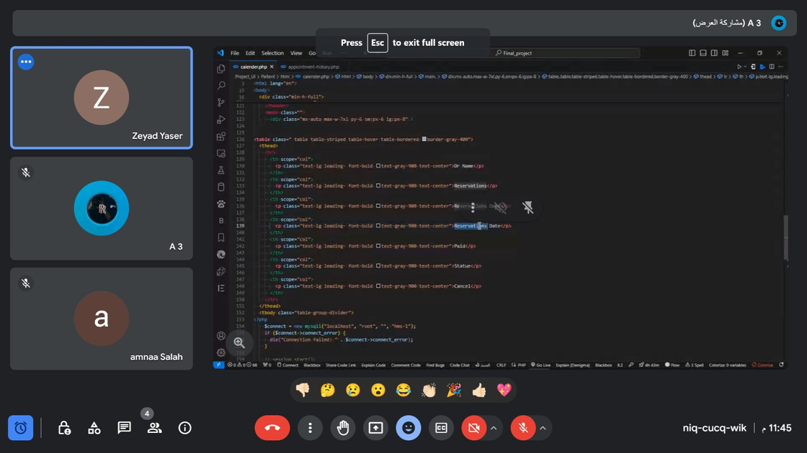
Meetings for Echo Team

Slide 11
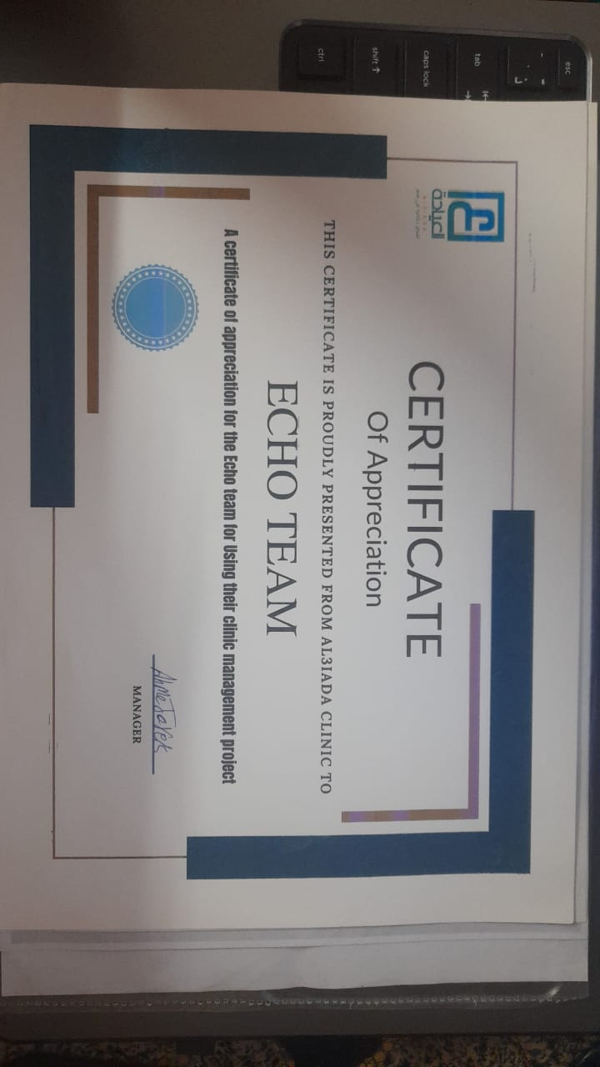
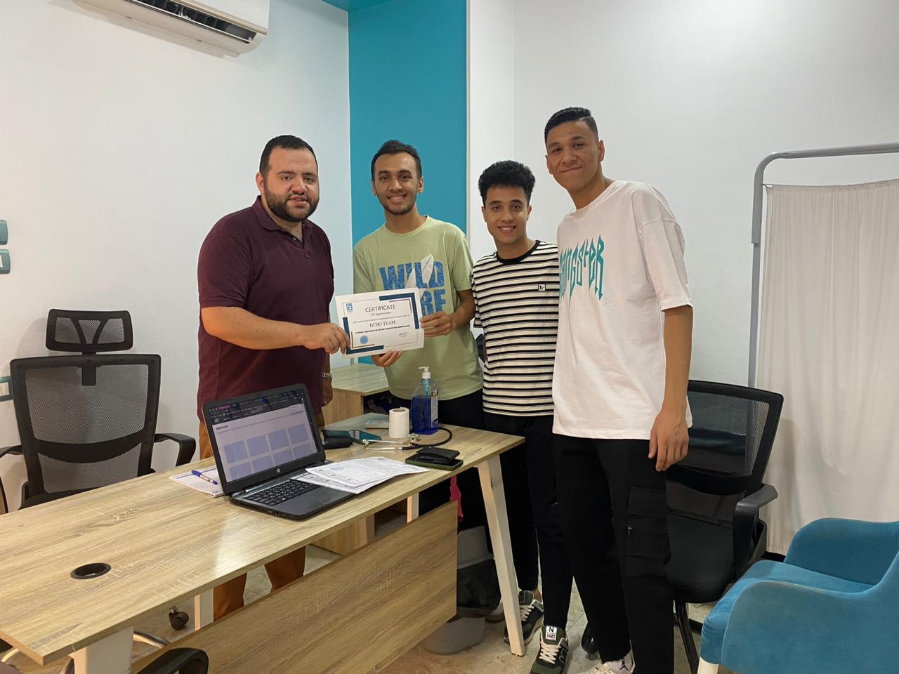
Field Trips
Al3yada Visit

Slide 12







Tools And Methods
We used a set of programming languages ​​and frameworks to produce an integrated product that serves patients and the medical organization
Front End Tools
Back End Tools
HTML
CSS
JAVA SCRIPT
PHP
SQL DATABASE
TAILWAND
BOOTSTRAP

Slide 13
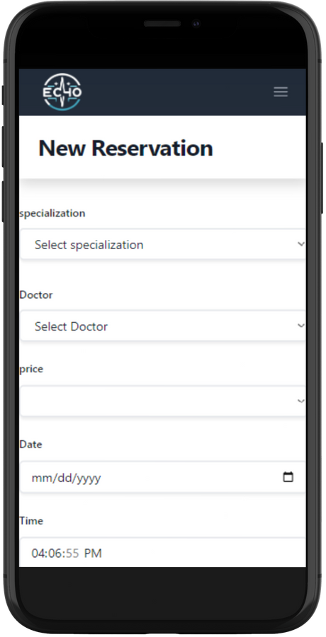
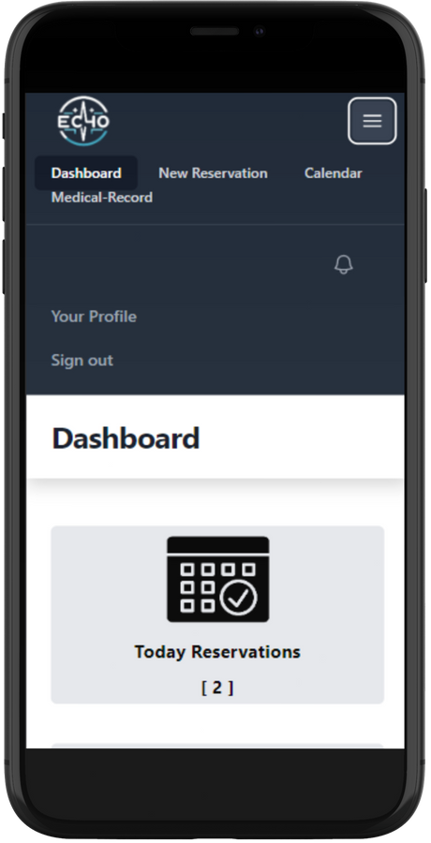
Future Work
We always Seek for development in the Eco system
We have a future vision and a good development plan
Which will add more great features to the Echo system and raise the level of service
Our plan for development is as follows :
Mobile application to facilitate use for the patient
A special API for sending messages to alert the patient that his appointment is approaching to reduce waiting and crowding through a message over the phone
Multiple payment methods online

Slide 14
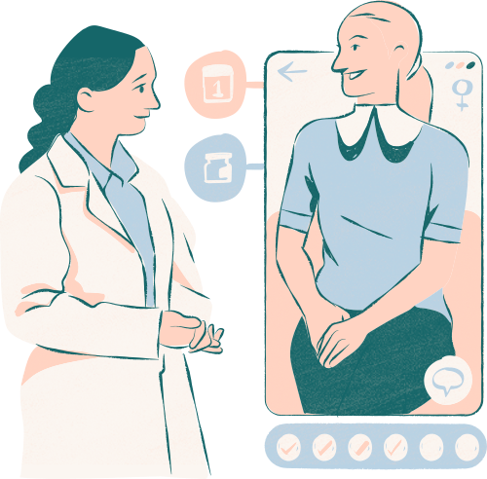
Add the patient's own reports after the doctor confirms the accuracy of the report Add the patient's own reports after the doctor confirms the accuracy of the report
Improving and developing the medical record automation process
Live chat within the system to facilitate sending consultations and ease communicating with the patient

Slide 15
Conclusion
in the ever-evolving landscape of healthcare management, harnessing the power of technology has become essential for clinics to thrive and deliver exceptional care. our medical clinic management project is a testament to the transformative potential of information technology revolutionizing healthcare operations in
by leveraging cutting-edge IT solutions, we have designed a system that goes beyond traditional clinic management models. our use of advanced AI technologies has enabled us to create a platform that is not only efficient, but also intelligent and adaptable
As we conclude this journey, we are reminded of the enormous potential of technology to revolutionize healthcare management.

Slide 16
Echo Medical System
Thanks for your attention
https://zeyad4a.github.io/ix/

Slide 17
https://zeyad4a.github.io/ix/

